Slide 1
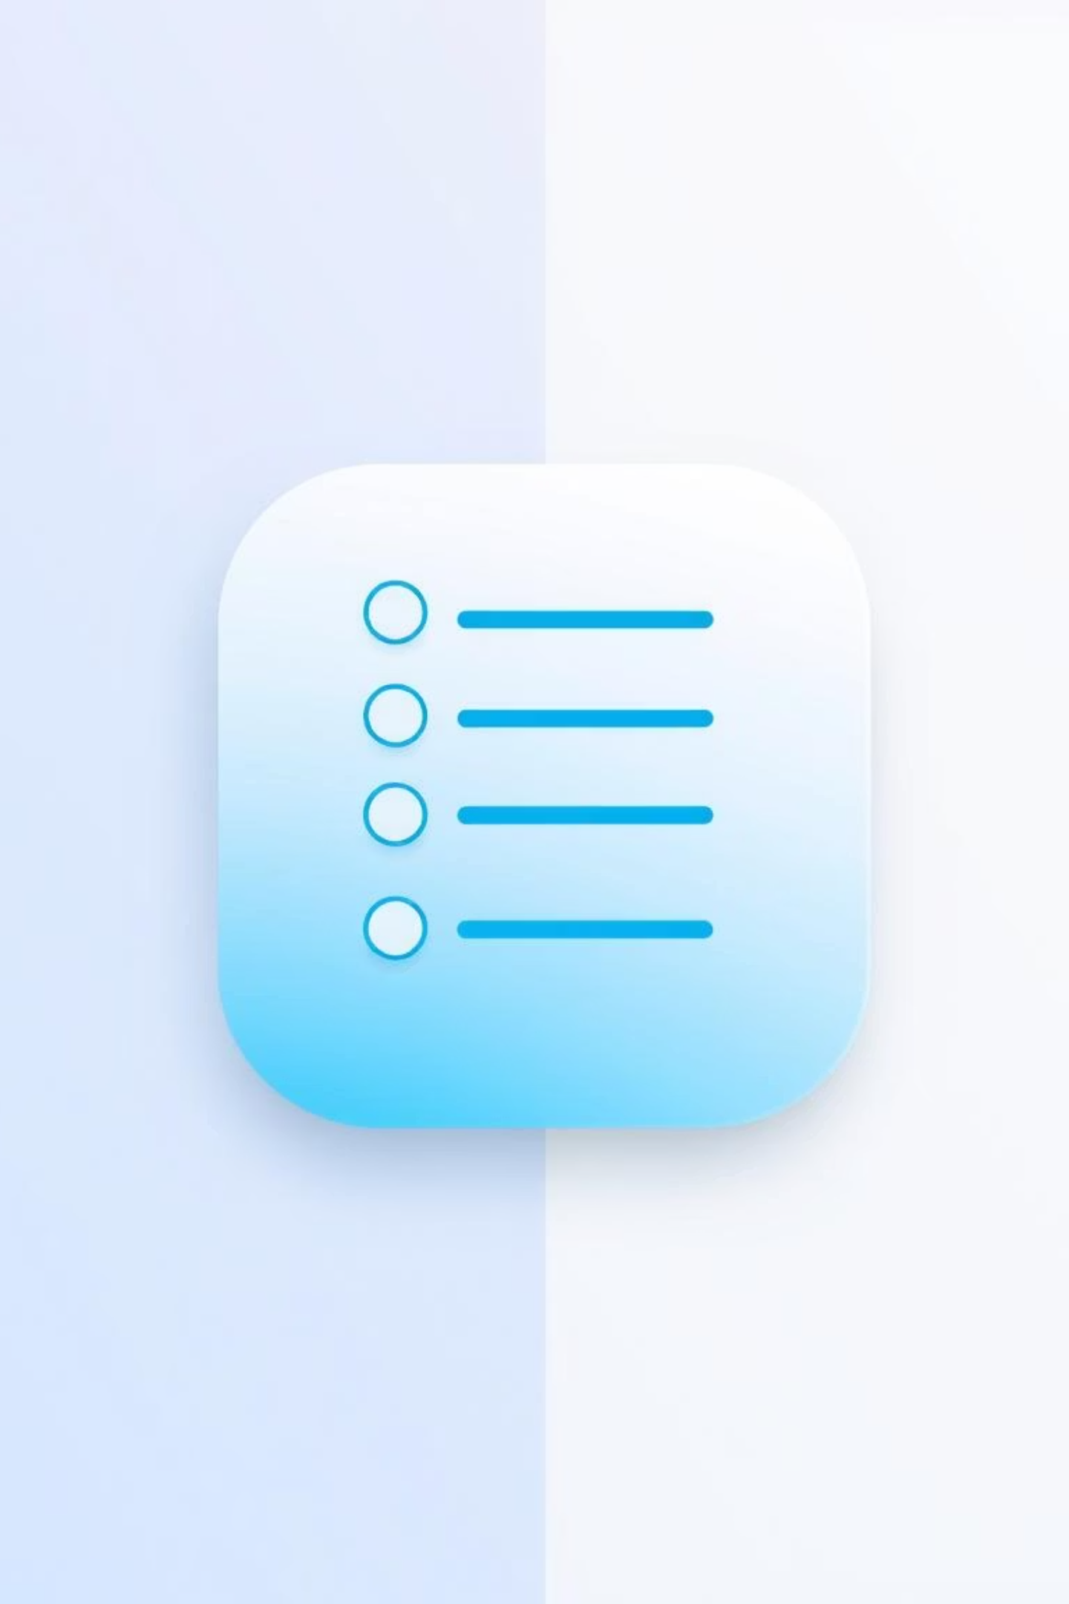
Android App Project – ToDoList
Welcome to the presentation for our ToDoList Android application. This app features intuitive task management.
Team Members:
Dhruv Hedaoo 23BCE11510
Manish Kumar 23BCE11528

Slide 2
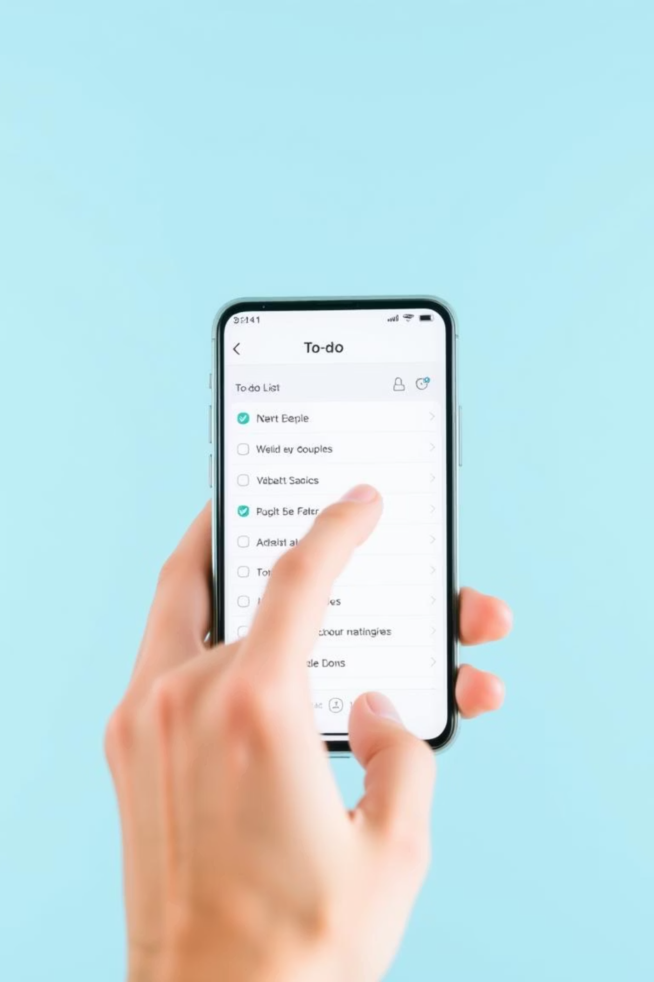
About the Idea
Efficient Task Management
Intuitive Interface
The interface is designed for ease of use. Adding, viewing, and deleting tasks is seamless.
The ToDoList app helps users manage daily tasks. It prioritizes simplicity and speed.
Gesture-Based Controls
Swipe actions enhance user interaction. Tasks can be deleted or archived with a single gesture.

Slide 3
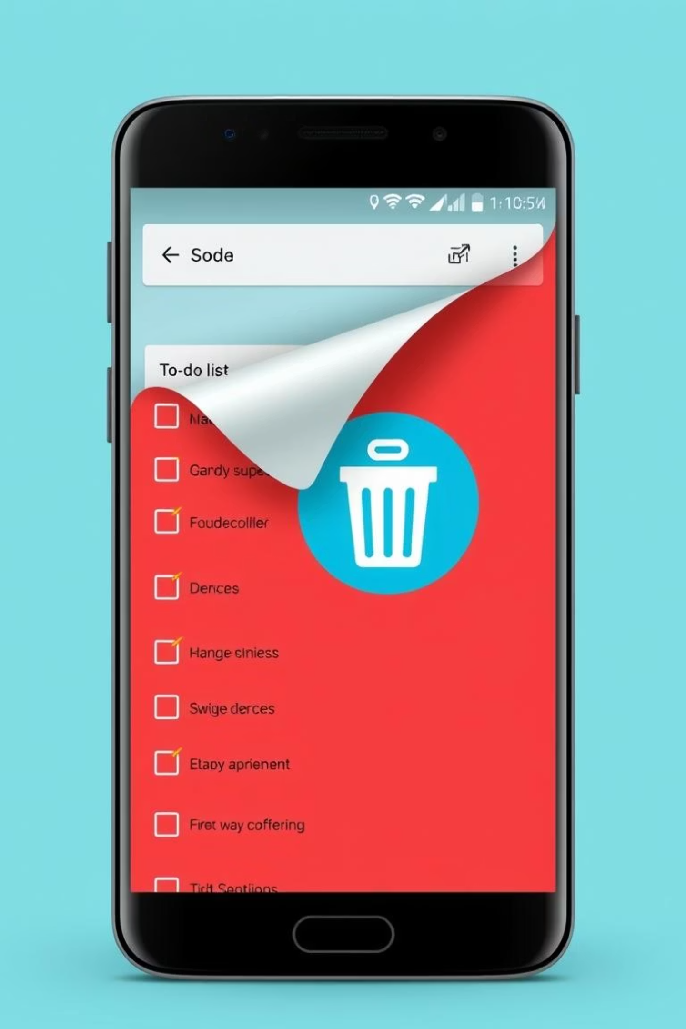
Solution
We implemented a custom swipe gesture. It uses the RecyclerViewSwipeDecorator library.
Custom Swipe Features
Custom icons like trash can or archive box.
Dynamic background colors based on swipe direction.
Descriptive text labels appear alongside icons.
Overall App Structure
Clean Material Design for user interface.
RecyclerView for efficient task list display.
Java backend logic manages all task operations.
Reusable adapter updates and displays task items.

Slide 4
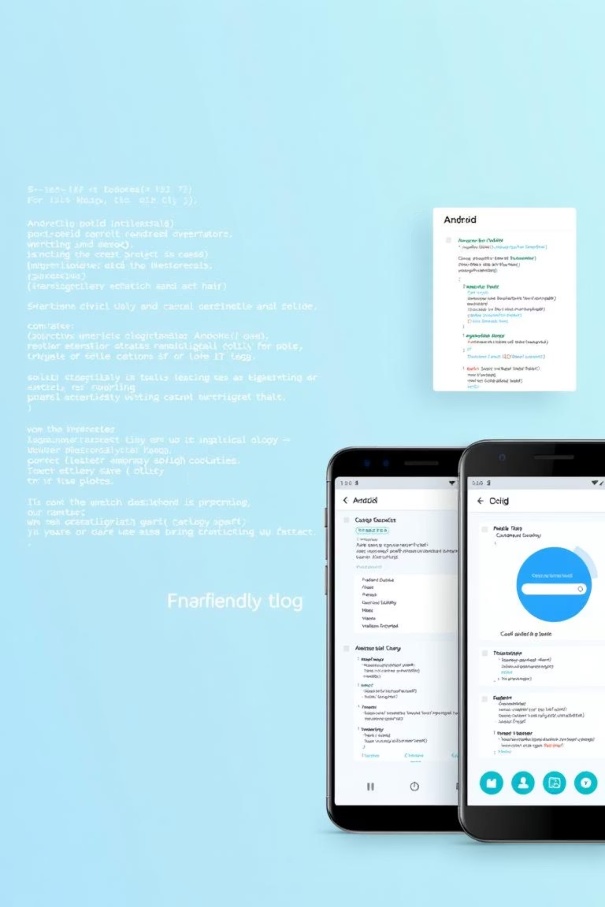



Concept
UI Design & Layouts
XML-based layouts for activity and list items, with Material Design.
RecyclerView with Swipes
ItemTouchHelper detects gestures, RecyclerViewSwipeDecorator renders.
Gradle & Project Structure
Gradle for dependencies; modular design for the library.

Slide 5
